Slide 1
Proof
PrintNet T
Notes:
Note to trainer: you can treat this presentation almost as a tutorial. As you introduce the concepts on the slide, show the trainees what it looks like in PrintNet T. Have them try as well while you progress. Any of the larger sample jobs will work as a sample WFD.

Slide 2
Context Schema
Workflow
Data Input
&
Manipulation
Document
Design
(Layout)
Impositioning
Approval (Proof)
Spool Production
Notes:
Proof is for viewing your job and your job’s data details, and occurs outside of the workflow.

Slide 3
Agenda
Proof Window
Data Proof Window

Slide 4
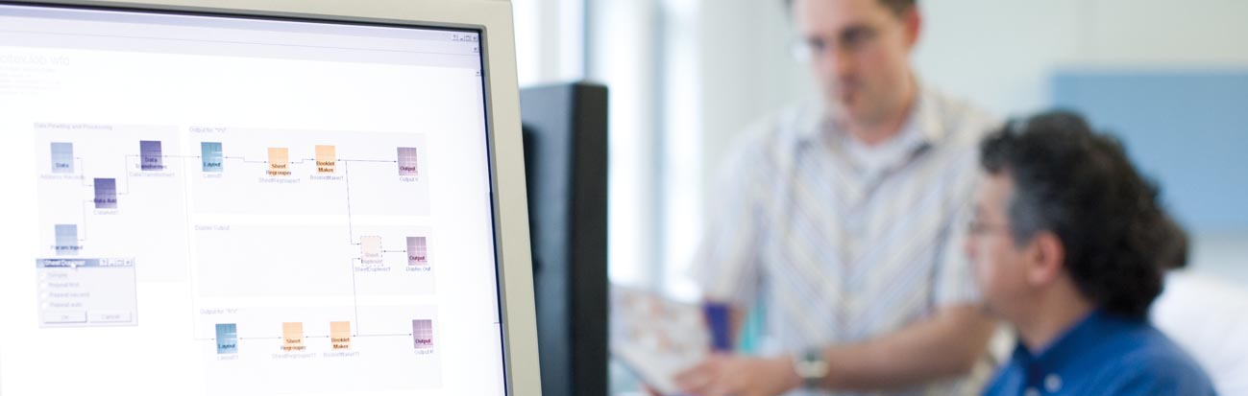
1. Proof Window

Slide 5

Introduction
WYSIWYG Proof
  After Layout has been designed, jobs can be proofed before they go to production:
  Press <F6>
Workflow | Run Proof
Design → Proof → Production
Notes:
WYSIWYG = “What you see is what you get”

Slide 6
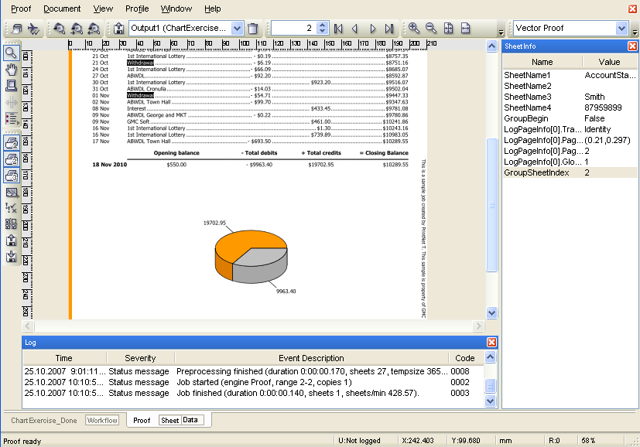
Proof Window Overview

Slide 7
Proof Window – Top
Print job from proof
Simulate printing speed for a range of pages in the job
Search for text string in proof
Open workflow or TNO and run in proof
Select workflow Output from which to proof
Unload workflow
Scroll through records
Select zoom settings for proof
Rotate page in proof
Select and/or edit proof profile

Slide 8

Proof Window – Left
Select Zoom tool
Select Hand tool for moving page in proof
Print Area tool allows you to set a specific area of the proof you want to be printed
Move currently defined virtual printing heads
Set if and when Script Debugger will run
Select printing groups to be proofed
Handling groups
Open Warning Config dialog
Allows you to edit workflow parameters
Open and save workflow configurations
Notes:
Print Area tool: click and drag over a small area of the page in proof; if subsequently printed, then only the area that falls within the Print Area will be printed.
Print Groups: in Layout, objects can be assigned to specific printing groups; that way, you can decide whether to include or remove particular objects from a job when printing from the proof screen.
Handling groups: can serve as color settings, when you want certain areas to be printed more sharply than others; they will fall into different handling groups.
Open Warning Config dialog: allows you to edit the level of severity and logging status of Proof warnings
Open and save workflow configurations: jobs will be saved as .JOB files.

Slide 9
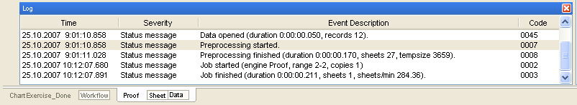
Proof Window – Bottom
Log Window: summarizes processing events
Proof Tabs: select either Sheet Proof or Data Proof
Notes:
The Log window summarizes the events of the processing of the workflow as the workflow is loaded. Afterwards, this events description can be used to help locate an errors that may have occurred.

Slide 10
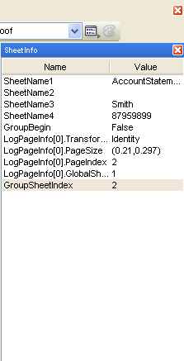
Proof Window – Right
Sheet info window provides information about the page that is being proofed (e.g., sheet name, applied transformations, size, etc.)
Sheet info window can be turned off in Window | Show SheetInfo

Slide 11
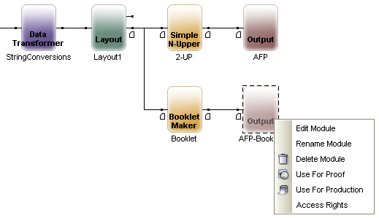
Proof – Output Selection
You can proof your document from any Layout or Output module. Depending on which module you select, your proof will appear different.

Slide 12
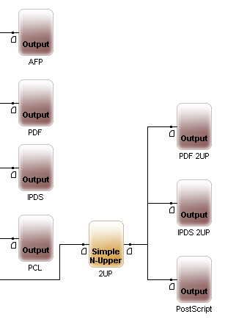
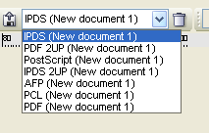
Proof – Output Selection
Alternatively, you can select your Output module in the Proof window itself.
Multiple Outputs in workflow
Multiple Outputs in proof

Slide 13
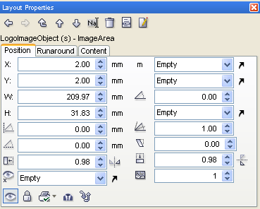
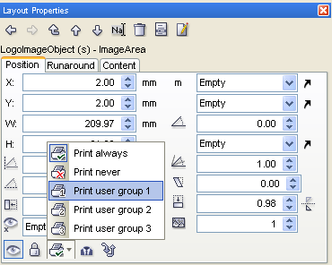
Layout – Print Groups
Set Print Groups for your objects in Layout Properties

Slide 14
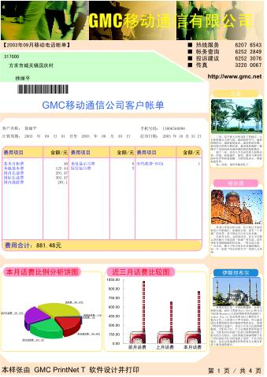
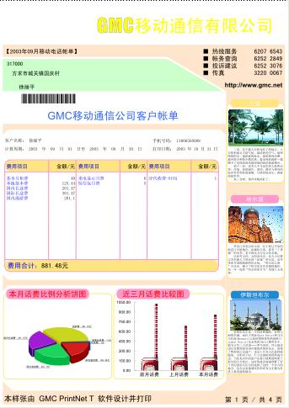
Proof – Print Groups
Groups 1, 2, and 3 turned on
Groups 2 and 3 on;
Group 1 turned off
Notes:
With print groups, you can assign images and other objects to specific groups. In proof, you can turn the Print Groups on and off to view your job with and without the Print Groups.
There are three Print Groups.
In this example, the header background image is part of print group 1.

Slide 15
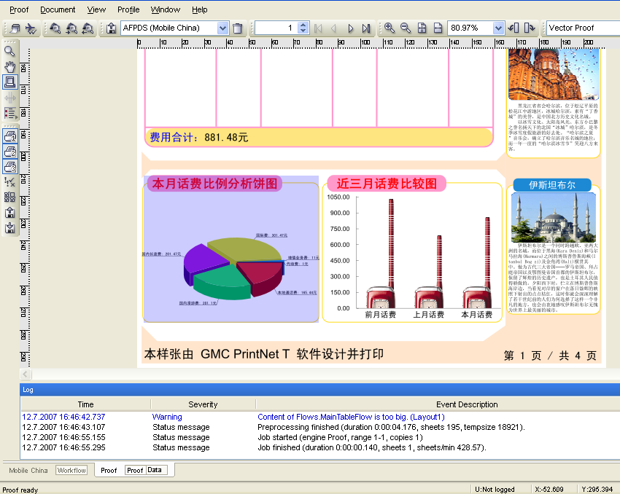
Proof – Print Area Tool
Allows us to specify part of the design to be printed

Slide 16
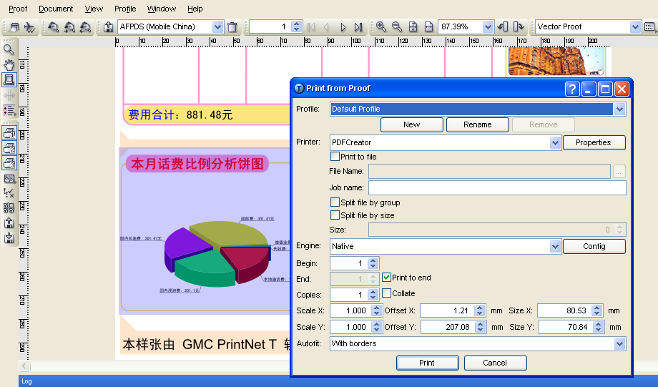
Proof – Printing
  If Print Area tool is used, the pre-selected values will be displayed
  when Print dialog is opened.
Notes:
Select your desktop printer
WinNative/ PCL

Slide 17
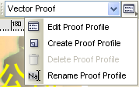
Proof – Proof Profiles
  Default is Vector Proof – resolution independent
  Right-click on Proof Profile button to create new Profiles
Notes:
Raster Proof – user-defined dithering mode, color feature, DPI , white processing, etc.

Slide 18
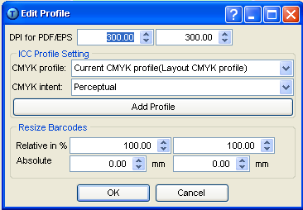
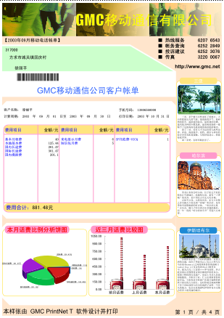
Vector Proofing Profiles
Vector Proof Settings
Proof Results
Notes:
The main difference between vector and raster graphics is that vector graphics are based upon mathematical equations, curves, and lines, whereas raster graphics are based upon a mapped collection of pixels. Vector graphics will resize when zoomed and enlarged; raster graphics will not – they will become blurry and block-like.
“Vector art is key for printing. Since the art is made from a series of mathematical curves it will print very crisp even when resized. For instance one can take the same vector logo and print it on a business card, and then enlarge it to billboard size and keep the same crisp quality. A low-resolution raster graphic would blur incredibly if it were enlarged from business card size to billboard size.”
Source: http://en.wikipedia.org/wiki/Vector_graphics

Slide 19
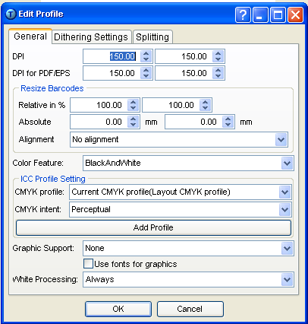
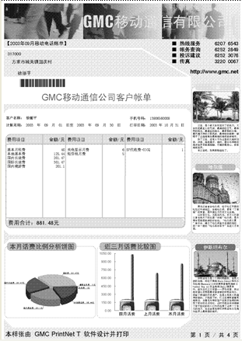
Raster Proofing Profiles
Raster Proof Settings
Proof Results
Notes:
The main difference between vector and raster graphics is that vector graphics are based upon mathematical equations, curves, and lines, whereas raster graphics are based upon a mapped collection of pixels. Vector graphics will resize when zoomed and enlarged; raster graphics will not – they will become blurry and block-like.
Raster Proof enables the simulation of the actual printer output
“Raster graphics cannot scale to an arbitrary resolution without loss of apparent quality. This deficiency contrasts with the capabilities of vector graphics, which easily scale to the quality of the device rendering them. Raster graphics deal more practically than vector graphics with photographs and photo-realistic images, while vector graphics often serve better for typesetting or for graphic design.”
Source: http://en.wikipedia.org/wiki/Raster_graphics

Slide 20
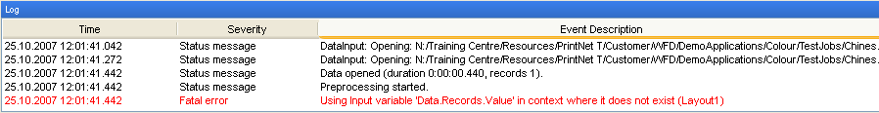
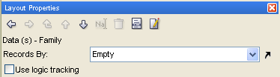
Proof – Log
  View the individual steps that took place during the job proof.
  Double-clicking on an error message gets you to the particular
  section where the error was identified.
Double-click
Takes you to Layout
No context!

Slide 21



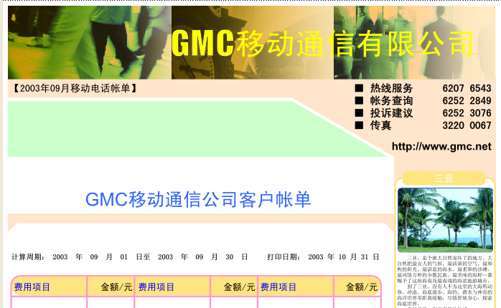

Proof – Show Overlays Example
Menu: View | Show Overlays
Notes:
Notice the overlays (objects) from Layout have been added to the proof in the second example.

Slide 22
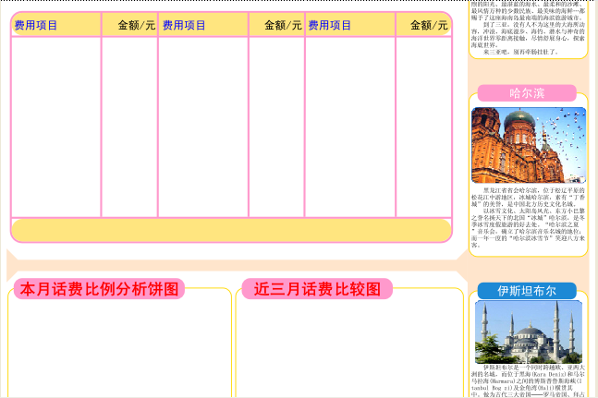
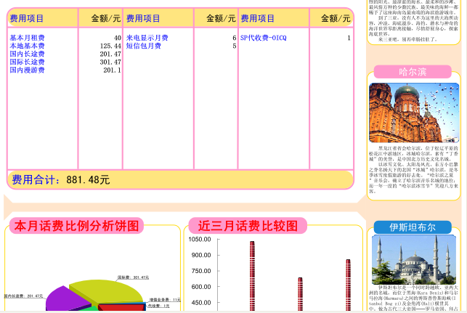

Proof – Show Variables Example
Menu: View | Show Variable Data
Notes:
Notice the variables from Layout have been added to the Proof in the second example.

Slide 23



Proof – Highlight Variables Example
Menu: View | Highlight Variables
Notes:
Notice the variables from Layout have been highlighted green in the proof in the second example.
Color of highlight can be changed in Proof | Options Dialog

Slide 24
2. Data Proof Window

Slide 25
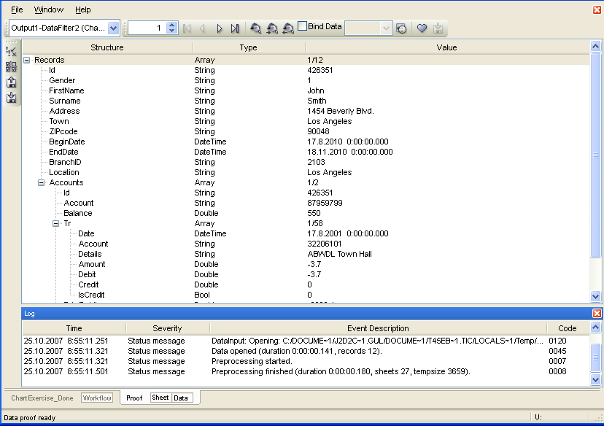
Data Proof Window Overview
Notes:
Data Proof shows the data structure in a certain step of data conversion (by default the last status - how the data come to Layout).
Navigation
Find
Bind Data
Favorite Items
Data Structure
Type
Values
Proof

Slide 26
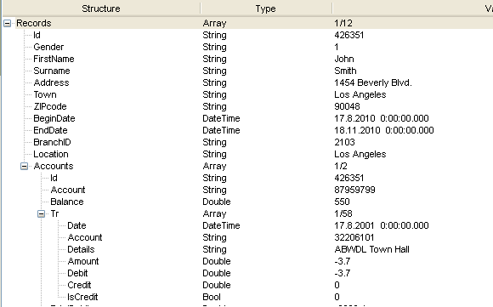
Data Proof – Data Window
Notes:
In Data Proof, each array can be expanded, and all individual records in each array can be viewed, with their different variables. To choose an array to view, simply click on it, and scroll using the record scroll buttons at the top of the proof screen.

Slide 27
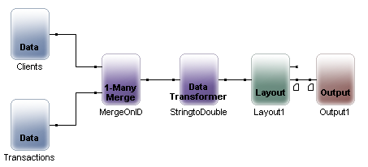
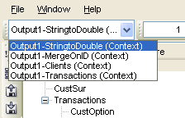
Data Proof – Output Selection
  (1) – Status just after Clients Data Input
  (2) – Status just after Transactions Data Input
  (3) – Status just behind MergeOnID 1-Many Merge Data Processor
  (4) – Status just behind StringtoDouble Data Transformer
Four data proof possibilities
1
3
4
2
Notes:
MyOutput1 is proofed
Sample_Letter.wfd is the name of the workflow

Slide 28
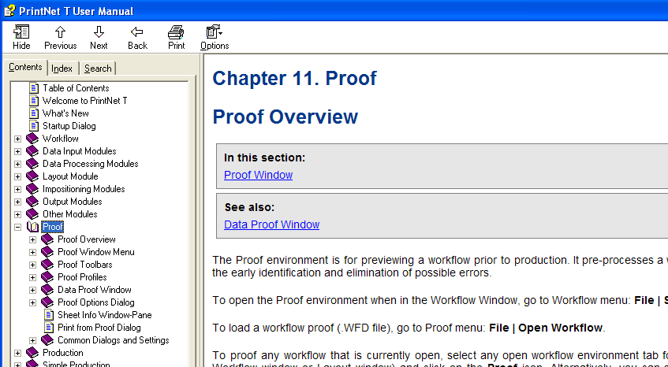
Proof – Q & A
There is a very extensive collection of information about proofing in the PrintNet T User Manual: Help | User Manual or <F1>.

Slide 29

Proof – Exercise
Assign Layout objects to Print Groups, and toggle the groups on and off in Proof.
  Open PrintGroupsExercise.wfd
  In Layout, assign the following objects to the following Print Groups:
      AccountBarcode Print Group 1
      CreditsDebitsChart Print Group 2
      GMCPropertyArea Print Group 3 (on both pages)
      ClassificationArea Print Group 3 (on both pages)
  Proof your job <F6>
  Toggle through your print groups to see the changes that are affected; scroll through your records to see all pages.
Notes:
Check PrintGroupsExercise_done.wfd for resolution.

Slide 30

Proof – Summary
In this presentation we have learned:
How to:
    Select from multiple Outputs in Proof
    Use the main features of the Proof and Data Proof windows
    Assign Layout objects to Print Groups, and how to navigate those Print Groups in Proof
    Assign a specific area of your proof to be printed
    Create new vector and raster proof profiles
    Show and hide overlays, variables, and how to highlight variables in a proof
    Scroll through records of more than one array in Data Proof
    Select various stages of the workflow (before the Layout module) for proofing in Data Proof

Slide 31

Proof – Discussion
How do you open Proof?
How do you print a certain area of a proof?
What are Print Groups?
How many Outputs are available in the Proof window?
Briefly, what is the difference between Vector and Raster?
Notes:
How do you open Proof?
Press <F6>.
How do you print a certain area of a proof?
Select the Print Area tool, drag and drop the area you want to print, and then click on the print button.
What are Print Groups?
Objects can be assigned to Print Groups, which can be toggled on and off in Proof and Production. Objects that belong to Print Groups that are deselected will not be visible in the proof, or when printed.
How many Outputs are available in the Proof window?
As many as there are in the workflow itself.
Briefly, what is the difference between Vector and Raster?
Vector uses mathematical equations to create its images; thus it can resize itself when enlarged. Raster uses mapped pixels, which don’t resize when enlarged.

Slide 32

Thank You.
Do You Have Any Questions?

